Slide 1
ECS7012P Music and Audio Programming

Slide 2
Music and Audio Programming
Class
Thursdays 1-2, Maths: MB-203
Fridays 3-5, Bancroft Road (CS Building / Student Union):3.01
Lecturer
Prof. Josh Reiss, joshua.reiss@qmul.ac.uk
Room 4.07, Engineering building (its almost impossible to find)
Labs – tentative, check your calendar!
ITL 2nd floor Lab
Monday 12-3,
Jan 27, Feb 10, Feb 24, March 2, March 9, March 16
Weeks 2, 4, 6, 7, 8, 9
Website
Course notes
Assignments
News, messages…
See QMPlus
qmplus.qmul.ac.uk/course/view.php?id=2419
Notes:
ECS730P/U/ECS623U Digital Audio Effects LAB ITL Middle Floor (North Front) weeks 2,4,6,7,9,11 2hrs 30 mins per lab Josh Reiss comp H657,642 elect H6S3,H6T8

Slide 3
Lab assignments
Lab assistant: Angeliki Mourgela
a.mourgela@qmul.ac.uk
Unmarked assignment: Audio effect analysis
Get JUCE, VST, Visual Studio up and running
Edit existing code, build simple plug-in
Unmarked
Assignment 2: Audio effect programming
Modify and program an example audio effect
Show that your code works correctly as a VST plug-in
Due: Early March
Assignment 3: Original audio effect
Create and investigate your own audio effect
Use programming environment of your choice
Results to be presented in class
Due: Late March
Lab assistant: Angeliki Mourgela
a.mourgela@qmul.ac.uk
Coursework 1 (20%): Audio effect analysis
Get Matlab Audio Toolbox up and running
Work through tutorial, build simple plugin
Unmarked
Coursework 2 (30%): Audio effect programming
Modify and program an example audio effect, e.g. multiband compressor
Show that your code works correctly as a VST plug-in
Due: Late February
Coursework 3 (50%): Original audio effect
Create and investigate your own audio effect
Use programming environment of your choice
Results to be presented in class
Due: Early April

Slide 4
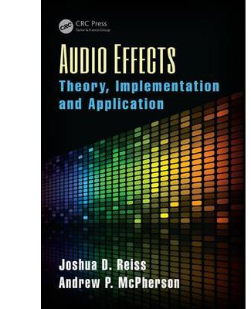
Primary text
Audio Effects:
Theory, Implementation and Application
Original text by J. Reiss and A. McPherson
Content to be posted on QMPlus each week
Includes
source code
audio samples
sample problems

Slide 5
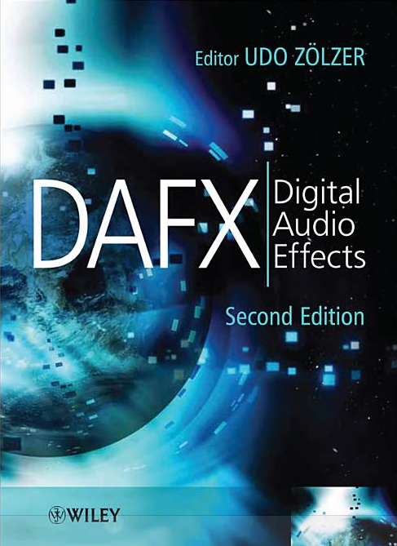
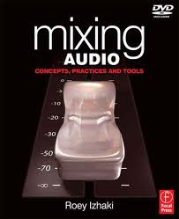
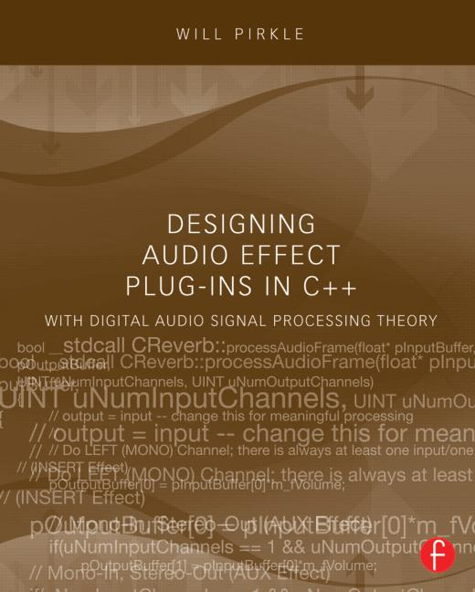
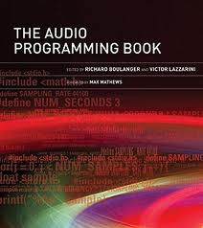
Recommended Books
DAFX - Digital Audio Effects, 2nd Edition
By Udo Zoelzer (Editor), 2011
Mixing Audio: Concepts, Practices and Tools
By Roey Izhaki, 2008
Designing Audio Effect Plug-ins in C++
By Will Pirkle, 2013
The Audio Programming Book
By Richard Boulanger & Victor Lazzarini (Editors), 2011

Slide 6
Want a good grade?
Attend the lectures
I might give hints
Study lecture notes
Primary source
Study the text
I’ll tell you which sections are relevant
Work through any problems I suggest
I’ll provide study guides
Browse additional materials
DAFx book
Julius Smith’s online publications
ccrma.stanford.edu/~jos/pubs.html

Slide 7
What you need to know
Signal representation
Basics of discrete time
Reading/writing audio files
Digital Systems
Impulse Response
Transfer functions
Frequency Response
IIR /FIR Filters
Visualisation
Signal Flow Graphs
Block Diagrams
Spectral Analysis
FFT
Windowing
Visualisation
Power Spectrum
Spectrogram
Time-Frequency Representation
Pseudo-Code
Matlab
C/C++
Know the basics, but we will revisit much of this

Slide 8
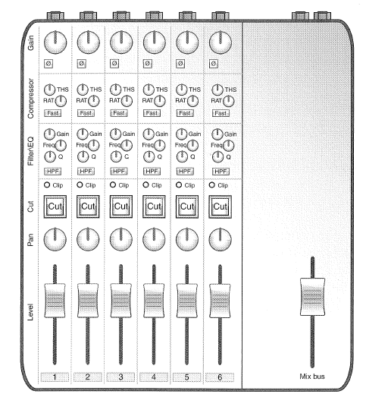
Module outline (1/2)
Introduction to DAFX
Representing and understanding digital audio
Modifying and processing digital audio
Delay-based effects
Echo
Comb filtering
Flanging, chorus
Filter design
Shelving filters, high order filters
Allpass filters
Filter effects
Graphic and parametric equalisation
Wah-wah, Phasers

Slide 9
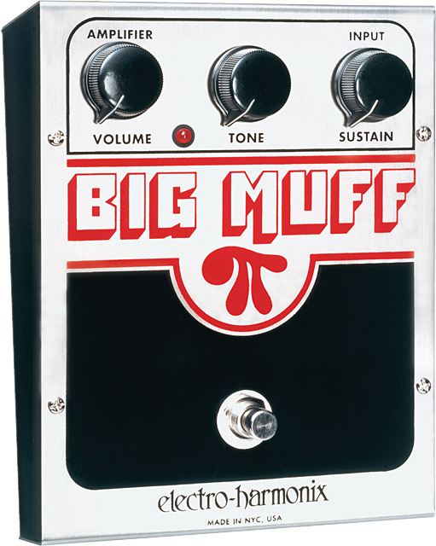
Module outline (2/2)
Amplitude modulation
Overdrive, distortion and fuzz
Dynamics processing
Compression, expansion
Limiting, de-essing
Phase vocoder
Pitch shifting; robotisation, whisperisation
Spatial audio
Doppler effect
Reverb
+ Audio production, audio programming

Slide 10

Sound Effects and Audio Effects
Sometimes used interchangeably, but...
Sound Effects
artificially created or enhanced sounds
emphasize audio content of movies, games, etc.
Audio Effects
used by anyone generating musical signals
special playing techniques by musicians
use of special microphone techniques
Digital and analogue effects and processors
Synthesis
Recording
Production
broadcasting

Slide 11
Digital Audio Effects (DAFX)
Modifies sound characteristic of input signal
Hardware boxes or software tools
input and output audio signals or sounds
modified according to parameters
input and output signals
digital format
represent sound
monitored by
loudspeakers
headphones
visual representation of signal
Waveform, level, spectrum…
control parameters
Set by sound engineer, musician, listener
Or can be part of digital audio effect
Digital audio effect and its control

Slide 12
Ursa Major Space Station
Launched in 1978
lowest cost segment of the market
$1,995 !
One of first generation of digital reverbs
Unique Interface

